Slide 1
Visual Literacy
Adapted from presentation by
JOEL A. MACHIELA & ABBY NAFZIGER

Slide 2
What is it?
Visual literacy is the ability t0 construct meaning from visual images.
Giorgis, C., & Johnson, N. (1999). Children's books: Visual literacy. Reading Teacher, 53(2), 146.
Notes:
Sounds pretty simple, but what does it mean? We see images all around us all the time, on television, on billboards, in books, all over. Aside from spur of the moment snapshots, many of the images we see are planned, their details carefully chosen. Visual literacy is about learning how those images are constructed and what gives images meaning. But before we get into that, we’ll talk about ….. NEXT SLIDE

Slide 3
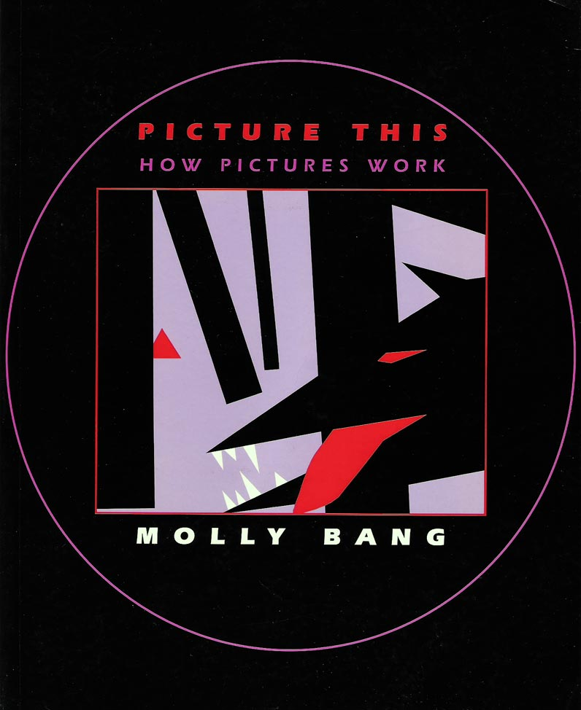
Looking at picture books
Elements of design
Line
Shape
Space
Color
Bang, M. (2000). Picture this: How pictures work.
San Francisco: SeaStar Books.
Notes:
How do pictures create emotional responses? Let’s take a look at some of these elements.

Slide 4
Line
an identifiable path created by a point moving in space.
(J. Paul Getty Trust, n.d.)
Notes:
What is a point moving is space?

Slide 5
Notes:
Point – moving in space. Very simple concept, but difficult to put into words. And line, when we’re talking about art, doesn’t have to be straight!

Slide 6
Notes:
But here’s a straight line. What do you see here? A solid horizontal line, creates stability, instantly creates space – horizon, creates ground and sky

Slide 7
Notes:
Lines create direction, pointing up, skyward. Take your eye from the bottom to the top

Slide 8
Notes:
Diagonal lines – dynamic, jarring, uneasiness, motion, tension

Slide 9
Shape
an object that has only height and width; usually defined by line, which can provide its contour.
(J. Paul Getty Trust, n.d.)

Slide 10
Notes:
Pointy shapes are dangerous, inspire fear, anxiety. If the character has to climb these mountains, you’ll probably be afraid for him/her

Slide 11
Notes:
But curved shapes are much safer, pleasant. These hills might evoke a nice, relaxing picnic or make you want to fly a kite or something.

Slide 12
Space
a feeling of depth or three dimensions. It can also refer to the artist's use of the area within the picture plane.
(J. Paul Getty Trust, n.d.)

Slide 13
Notes:
Relationships between objects: which is the closest?

Slide 14
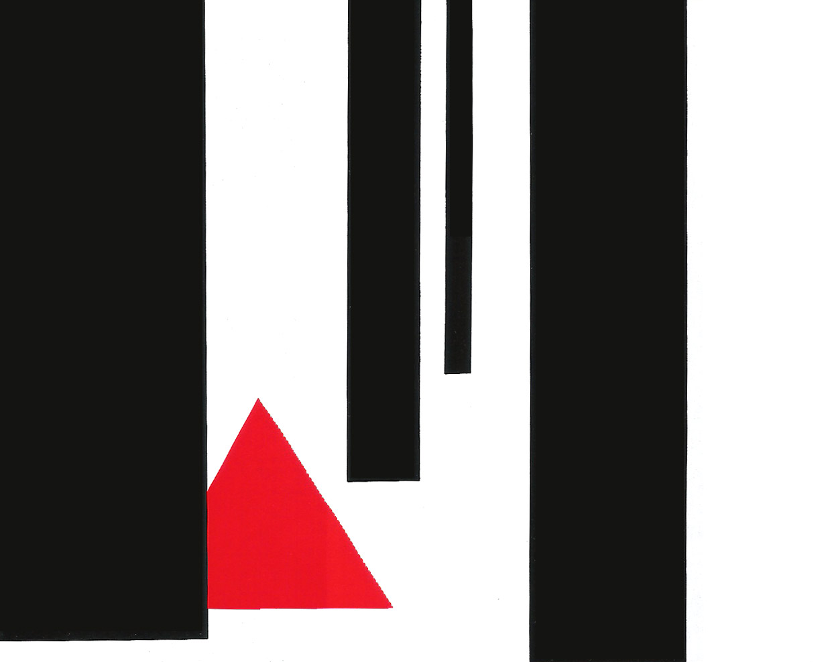
Notes:
Little red is behind one tree and in front of another. If we make the triangle smaller and move it up….

Slide 15
Notes:
It appears that Little red is now much further back

Slide 16
Color
light reflected off objects.
(J. Paul Getty Trust, n.d.)
Notes:
What does that mean? Use a person’s shirt as an example. White light has all colors. When it hits (red) shirt, all colors except red are reflected back, red is absorbed by that shirt. Black is no colors, meaning that all colors are absorbed by black.

Slide 17
Notes:
Take a look at the wolf’s eye. The pale violet color might be a good choice, it could add a touch of realism to the picture, but how does it interact with the other elements of the picture? If we make one small change…

Slide 18
Notes:
… we change the feeling of the picture altogether. Just by making the eye red, it instantly draws the reader’s attention. It is a strong color, an angry, sometimes evil color and it also serves to add symmetry to the picture. The eye and the triangle are now visually linked. What is it about color that creates this effect?

Slide 19
Describing Color
Cool
Warm
Notes:
Colors have an innate feeling attached to them. In the color wheel we have what we perceive as warm colors and cool colors. Illustrators use these perceptions in their art to achieve a particular mood for their scenes.

Slide 20
Describing Color
Hue
red, green, blue, etc.
Value
the brightness of color: light or dark
Intensity
describes the purity or strength of a color: bright or dull
(J. Paul Getty Trust, n.d.)

Slide 21
Reading Pictures

Slide 22
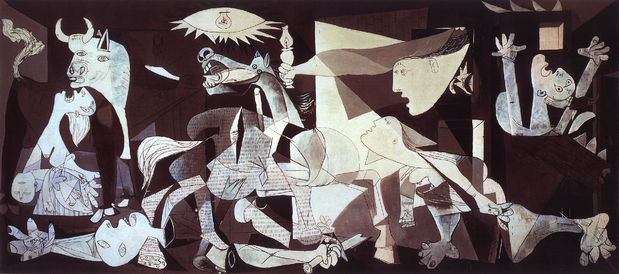
Picasso, P. (1937). Guernica. [Painting]. Madrid, Spain: Museo Reina Sofia.
Notes:
Chaotic, overwhelming

Slide 23
Notes:
Individual scenes, pain, death of war

Slide 25
Beitler, L. (1930, August 7). Untitled.
[Photograph]. Marion, Indiana.
Notes:
What’s going on here?

Slide 27
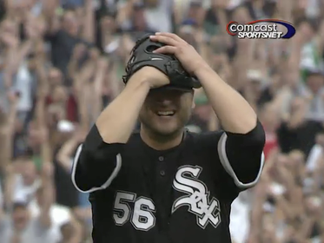
Major League Baseball. (2009, July 23). Tampa Bay at Chicago. [Broadcast]. Chicago: Comcast SportsNet.
Notes:
What’s going on in this photo? Somewhat ambiguous. Clues? People in the background? Facial expression?

Slide 28
On July 23, 2009 Chicago White Sox pitcher Mark Buehrle threw a perfect game against the Tampa Bay Rays, giving up zero hits or walks.
Notes:
What’s going on in this photo? Somewhat ambiguous. Clues? People in the background? Facial expression?

Slide 29
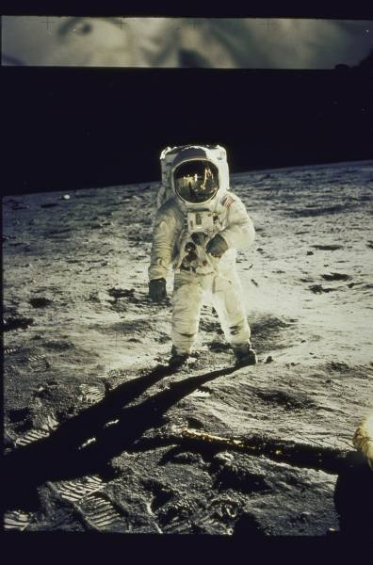
Armstrong, N. (1969, July 20). Apollo Xi. [Photo]. Google: LIFE Photo Archive.

Slide 32
Widener, J. (1989, June 5). Tank Man. [Photo]. Tiananmen Square, China: Associate Press

Slide 33
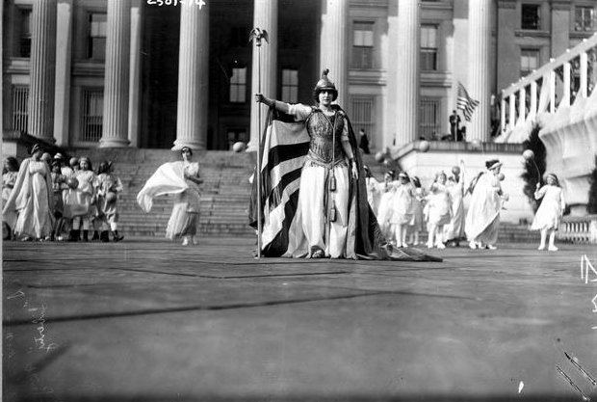
[Unknown]. (1913, March). By Popular Demand. [Photo]. George Grantham Bain Collection: Library of Congress

Slide 34
Florence Fleming Noyes, full-length pose, wearing costume of "Liberty" at suffrage pageant, other participants standing in background in front of the Treasury Building, Washington, D.C.

Slide 35
Resources:
Armstrong, N. (1969, July 20). Apollo Xi. [Photo]. Google: LIFE Photo Archive.
Bang, M. (2000). Picture this: How pictures work. San Francisco: SeaStar Books.
Beitler, L. (1930, August 7). Untitled. [Photograph]. Marion, Indiana.
Giorgis, C., & Johnson, N. (1999). Children's books: Visual literacy. Reading Teacher, 53(2), 146.
J. Paul Getty Trust. (n.d.). The elements of art. The Getty. Retrieved June 15, 2010, from http://www.getty.edu/education/teachers/building _lessons/elements.html#line

Slide 36
Resources:
Major League Baseball. (2009, July 23). Tampa Bay at Chicago. [Broadcast]. Chicago: Comcast SportsNet.
Picasso, P. (1937). Guernica. [Painting]. Madrid, Spain: Museo Reina Sofia.
[Unknown]. (1913, March). By Popular Demand. [Photo]. George Grantham Bain Collection: Library of Congress.
Using Primary Sources (Teacher ed.). (n.d.). [Pamphlet]. Retrieved from http://www.loc.gov/teachers/usingprimarysources/
Widener, J. (1989, June 5). Tank Man. [Photo]. Tiananmen Square, China: Associate Press.

