Slide 1
The iPod Touch
By: Angela Pham

Slide 2
What I Know
You can go online on the iPod touch.
The iPod touch can hold songs, videos, or photos.
Apple made the iPod touch.
The iPod touch is expensive.
The iPod touch has a touch screen.

Slide 3
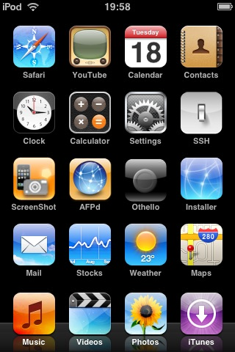
What I Want to Know and What I Learned
Q: How does the touch screen work?
A: When your finger touches the screen, you change the electrical properties of the screen. The iPod records this change as data, and it uses mathematical algorithms to translate the data into an understanding of where your fingers are.
Q: What is the difference between the iPod touch and the iPhone?
A: The iPhone has more on it than the iPod touch. The iPhone has a phone, camera, and Bluetooth. Also on the iPhone you will always be connected to the internet while on the iPod touch, you can only connect through a Wi-Fi connection.

Slide 4
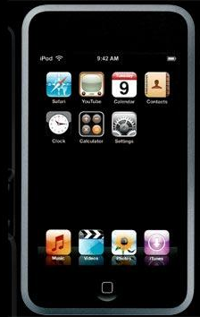
Continued…
Q: What are some of the features of the iPod touch?
A: The iPod touch has Wi-Fi capabilities, a clock, a calculator, a YouTube player, mail, Google Maps, Weather, Stocks, Notes, and it holds songs, videos, and/or photos.
Q: When you purchase an iPod touch, what other items does it come with?
A: Earphones, a dock, a stand, USB cable, a case, and a cleaning cloth

Slide 5
Things to Know When Buying the iPod Touch
You can buy a 8GB, 16GB, or a 32GB iPod touch.
The 8GB costs $299 and holds 1,750 songs.
The 16GB costs $399 and holds 3,500 songs.
The 32GB costs $499 and holds 7,000 songs.

Slide 6
Bibliography
“iPod Touch.” No date. Online image. Gizmodo. 10 March 2008. <http://www.gizmodo.com.au/2007/09/02/ipod-touch-flat.jpg>.
“Apple Logo.” No date. Online image. Gizmodo. 10 March 2008. <http://cache.gizmodo.com/assets/resources/2007/10/3d_Apple_Logo_102.jpg>.
“iPod Touch.” No date. Online image. Gadgetmadness. 10 March 2008. <http://www.gadgetmadness.com/archives/ipod_touch_hero_image20070905.png>.
“Apple iPod Touch.” No date. Online image. Digitaltechnews. 10 March 2008. <http://www.digitaltechnews.com/news/images/2007/09/05/ipod_touch.jpg>.
“iPod Touch.” No date. Online image. Techgadgets. 10 March 2008. <http://www.techgadgets.in/images/ipod-touch-2.jpg>.
“iPod Touch Menu.” No date. Online image. Singeo. 10 March 2008. <http://www.singeo.com.sg/singeo/images/itouch1.jpg>.
“iPod Touch Finger.” No date. Online image. Markgamis. 10 March 2008. <http://markgamis.blogspot.com/2007/10/first-hand-encounter-with-ipod-touch.html>.

Slide 7
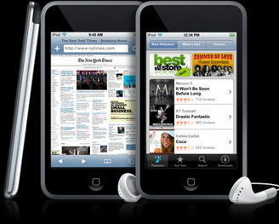
Works Cited
“Apple Announces Major Software Upgrade for iPod Touch.” M2PressWIRE 16 Jan. 2008. Newspaper Source. EBSCO. Mehlville High School Library, St. Louis. 7 Feb. 2008. <http://search.ebscohost.com/login.aspx?direct=true&db=nfh*AN=16PU3676698858&site=ehost-live>.
Ford, Ric. “iPod Touch.” 18 Sep. 2007. 13 Feb. 2008. <http://www.macintouch.com/reviews/ipodtouch/>.
Goldwasser, Josh. Personal interview. 17 Feb. 2008.
Kevin. “Apple iPod Touch Review.” 8 Oct. 2007. 7 Feb. 2008. <http://www.brighthand.com/default.asp?newsID=13405>.
Takahashi, Dean. “BRIEF: First look: Upgraded iPod Touch: First look: Upgraded iPod Touch.” San Jose Mercury News (CA) 21 Jan. 2008. Newspaper Source. EBSCO. Mehlville High School Library, St. Louis. 7 Feb. 2008. <http://search.ebscohost.com/login.aspx?direct=true&db=nfh&AN=2W62W64275590112&site=ehost-live>.
Wilson, Tracy V. “How the iPod Touch Works.” Howstuffworks.com 11 Sep. 2007. Howstuffworks. 7. Feb. 2008. <http://electronics.howstuffworks.com/ipod-touch.htm/printable>.

